Slide 1

THE 7 TYPES OF REST THAT EVERY PERSON NEEDS

Slide 2
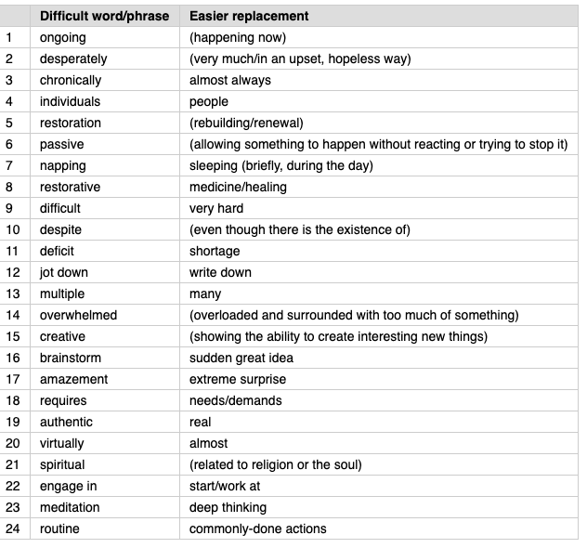
although
habit

Slide 3

FILL IN THE GAPS WITH THE CORRECT WORDS
1. Let’s ------------------------ ideas for our project.
2. Many african countries have a big ---------------------- in food supply.
3. You can ------------------- some important points while I’m explaining it to you.
4. You need to treat your students as ------------------.
5. Don’t worry, there are extra copies. We made ----------------- copies of the report.
6. She is a very --------------------- person. She always comes up with new ideas.
7. She was -------------------- by the excitement of passing the test.
8. My dad likes having a ------------------------- after the meals.
9. Pollution continues to be a /an ---------------------- problem for our city.
10. Training to be a doctor ------------------------ a lot of hard work.
11. He wants to escape from his monotonous -----------------------.
12. They say Basque is one of the most ------------------------- languages to learn.
Choose 4 words. Write your sentences.
individual, jot down, nap, ongoing, difficult, despite, deficit, multiple, overwhelmed, creative, brainstorm, require, routine

Slide 4

Let’s Talk
How many hours do you need to sleep?
Do you ever think sleep wastes valuable time spent doing useful things?
What do you do in the minutes before you sleep?
What do you do when you can’t sleep?
What does nap mean?
Do you nap?
What causes stress?
Do you think stress is ever good, useful, or necessary? Why or why not?
How can you live a stress free life?
What do you do to relax? How do you rest?
What do you think about meditation, yoga, massage?
You can revise the vocabulary by clicking the link:
https://wordwall.net/resource/9467684

Slide 5
THE 7 TYPES OF REST THAT EVERY PERSON NEEDS
Have you ever tried to fix an ongoing lack of energy by getting more sleep and failed?
If that’s you, here’s the secret: Sleep and rest are not the same thing.
We go through life thinking we’ve rested because we have had enough sleep — but in reality we are missing out on the other types of rest we desperately need. The result of it is chronically tired and burned-out individuals. We’re suffering from a lack of rest because we don’t understand the true power of rest.
Rest should equal restoration in seven key areas of your life.
The first type of rest we need is physical rest, which can be passive or active.
Passive physical rest includes sleeping and napping. Active physical rest means restorative activities such as yoga, stretching and massage therapy that help improve the body’s circulation and flexibility.
The second type of rest is mental rest.
Do you know that colleague who starts work every day with a huge cup of coffee? He’s often nervous and forgetful, and he has a difficult time focusing on his work. When he lies down at night to sleep, he often struggles to turn off his brain as conversations from the day fill his thoughts. And despite sleeping seven to eight hours, he wakes up feeling as if he never went to bed. To fix this, schedule short breaks every two hours during the day; these breaks can remind you to slow down. You might also keep a notebook by the bed to jot down any thoughts that would keep you awake.
The third type of rest we need is sensory rest.
Bright lights, computer screens, background noise and multiple conversations can cause our senses to feel overwhelmed. To fix this, close your eyes for a minute in the middle of the day and unplug from electronics at the end of every day.
The fourth type of rest is creative rest.
This type of rest is especially important for anyone who must solve problems or brainstorm new ideas. Creative rest reawakens the amazement and wonder inside each of us. Do you remember the first time you saw the sea, the ocean or a waterfall? Allowing yourself to take in the beauty of the outdoors — even if it’s at a local park or in your backyard — provides you with creative rest.
But creative rest also includes enjoying the arts. Turn your workspace into a place of inspiration by putting images of places you love and works of art that speak to you.
This person requires emotional rest, which means having the time and space to freely express your feelings.
Emotional rest also requires the courage to be authentic. An emotionally rested person can answer the question “How are you today?” with a truthful “I’m not okay”.
If you’re in need of emotional rest, you probably have a social rest deficit too.
To experience more social rest, surround yourself with positive and supportive people. Even if your interactions have to happen virtually, you can choose to engage more fully in them by turning on your camera and focusing on who you’re speaking to.
The final type of rest is spiritual rest, which is the ability to connect beyond the physical and mental and feel a deep sense of belonging, love, acceptance and purpose.
To receive this, engage in something greater than yourself and add prayer, meditation or community involvement to your daily routine.
As you can see, sleep alone can’t restore us to the point we feel rested. So it’s time for us to begin focusing on getting the right type of rest we need.
Adapted and simplified from Dr. Saundra Dalton-Smith’s TED Talk
You can watch it from here: https://www.youtube.com/watch?v=ZGNN4EPJzGk&feature=emb_logo

Slide 6

ANSWER THE QUESTIONS
Can we always rest if we sleep enough?
Can you give 2 examples for active physical rest?
What happens if we are not mentally rested?
Do you agree with Dr. Saundra Dalton-Smith about creative rest?
Is it easy for you to say ‘No’?
What should we do to fix our social rest deficit?
Homework:
Are you stressed or not?
Do this quiz.
http://www.bbc.co.uk/news/special/2013/newsspec_6115-b/english/index.html?v=1.1.0#
Watch the TED Talk: https://www.youtube.com/watch?v=ZGNN4EPJzGk&feature=emb_logo

